Slide 1
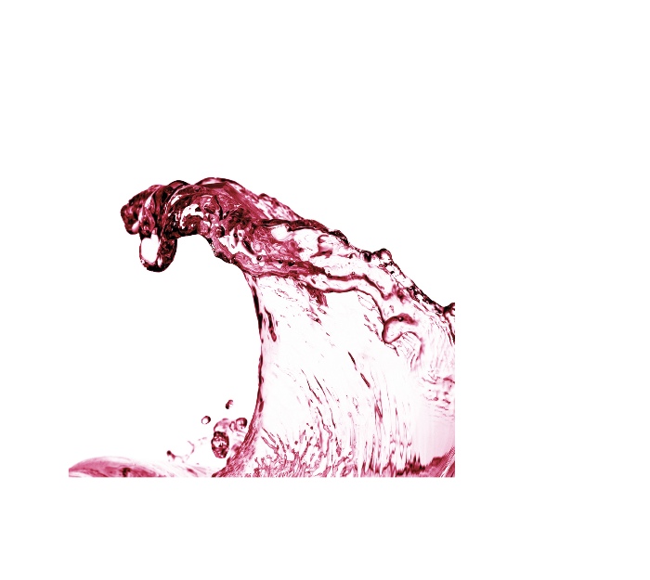
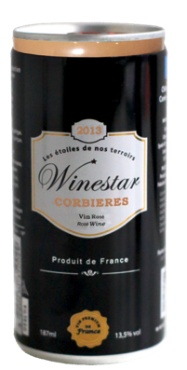
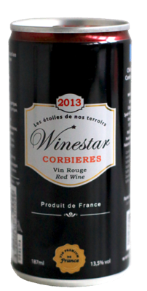
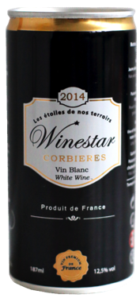
Equity fund raising

Slide 2
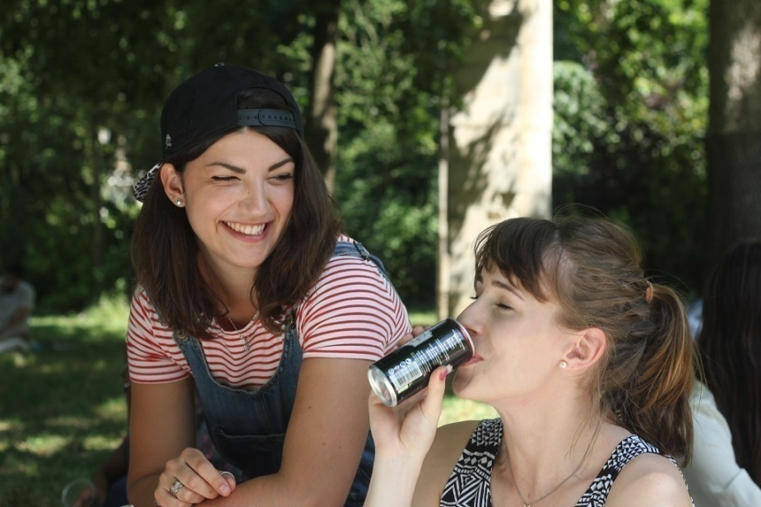
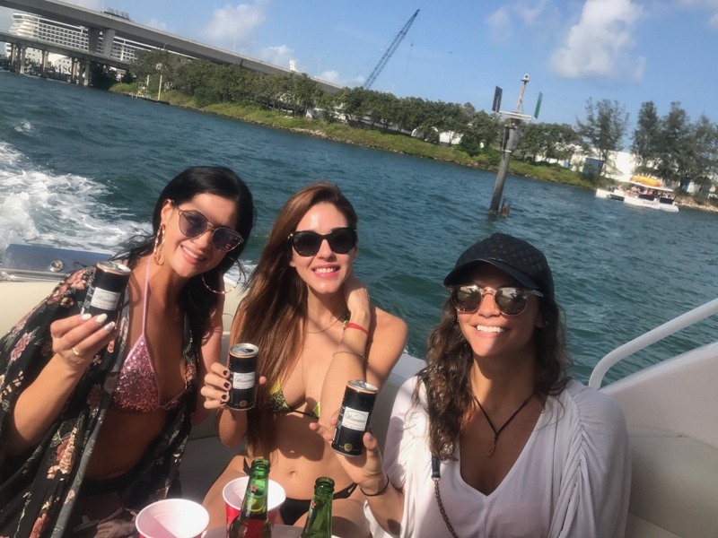
Winestar introduction
Winestar was launched in 2013 and already sold over 1 million cans worldwide,
A can especially designed for optimal wine preservation,
First innovation in wine packaging since bag-in-box in 1973...
A single-serve, innovative and trendy package for casual consumption,
Offer a responsible drinking solution, targeting millennials (18-35 years old),
Steal market shares from the beer category, leader for alcoholic beverages in a single-serve…
Become the leader for wine in cans globally and create the #1 brand for wine in cans.

Slide 3
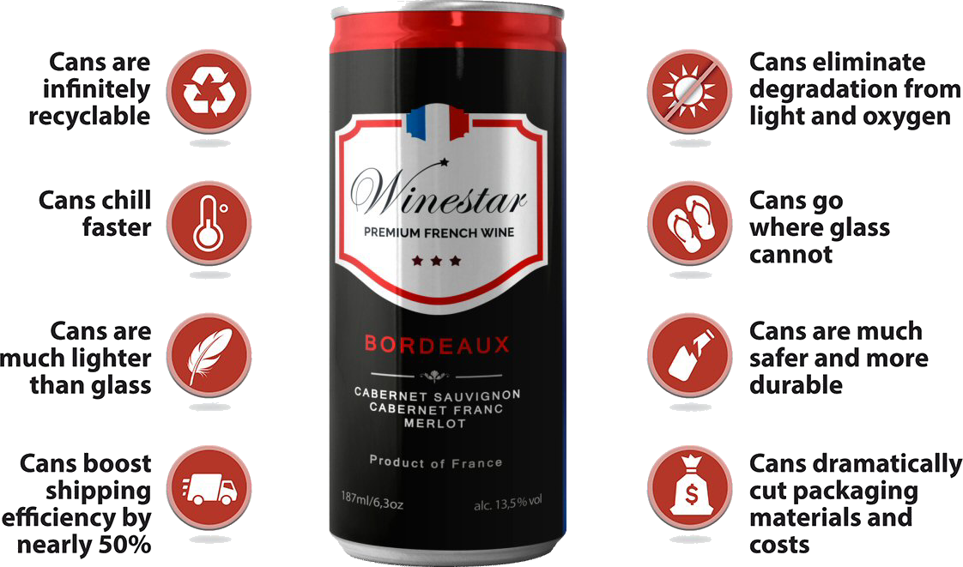
Benefits of the wine in can

Slide 4
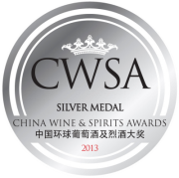
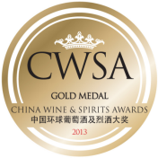
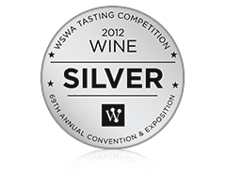
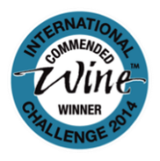
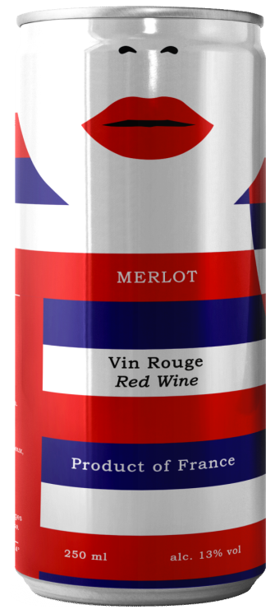
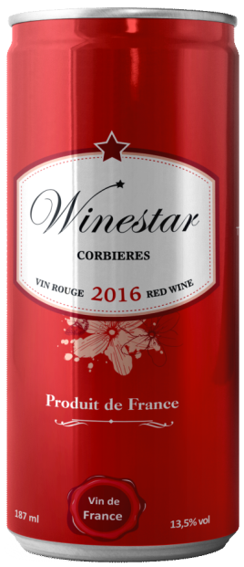
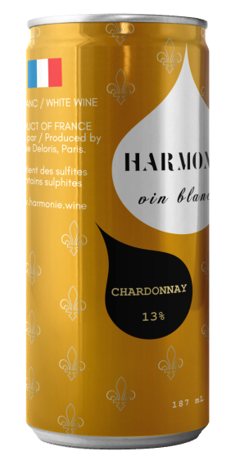
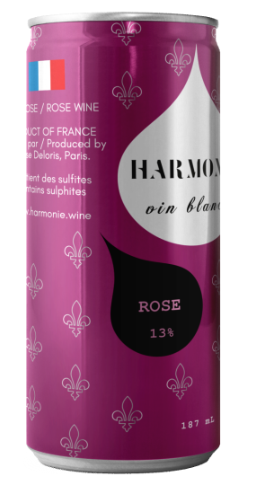
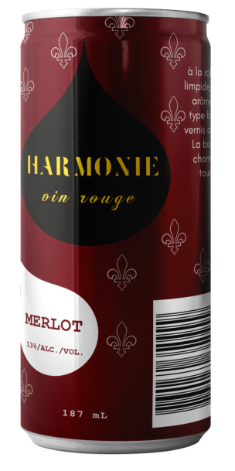
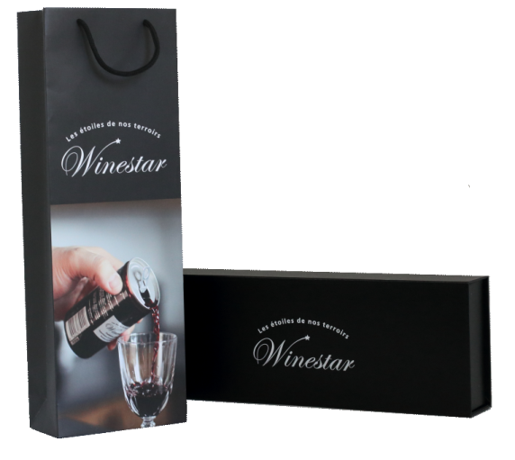
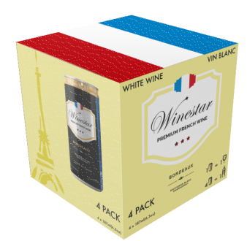
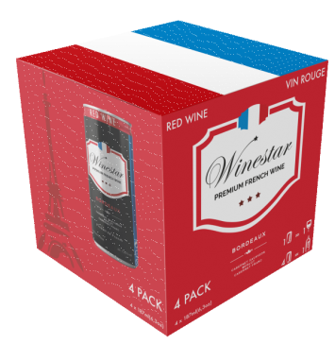
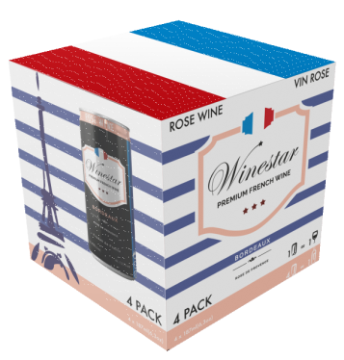
Award winning wines for everyone
A choice of quality wines, adapted to the various markets, and every market segment
Premium range AOC Winestar
Localization (Chine)
Range IGP Harmonie
OEM design
Ex: Kiravi brand
Gift box
and duty-free
Packs x 4
Displays

Slide 5
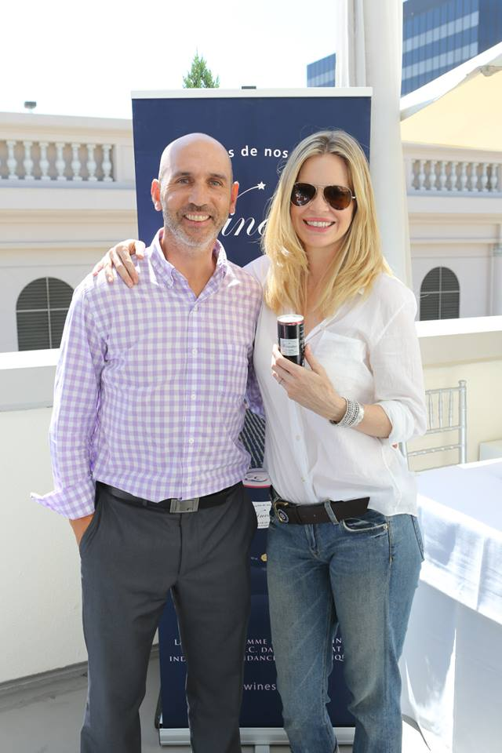
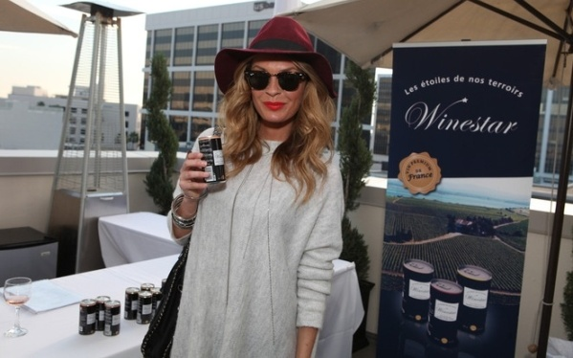
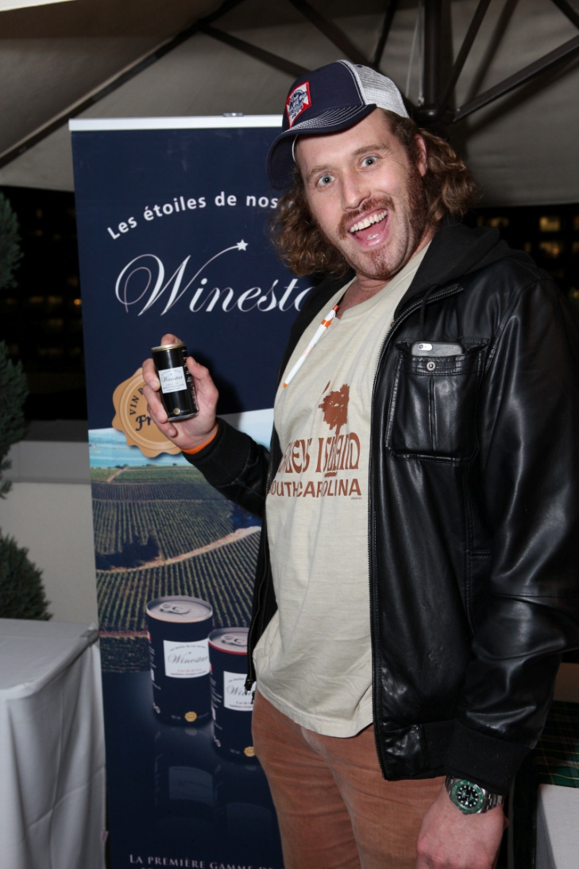
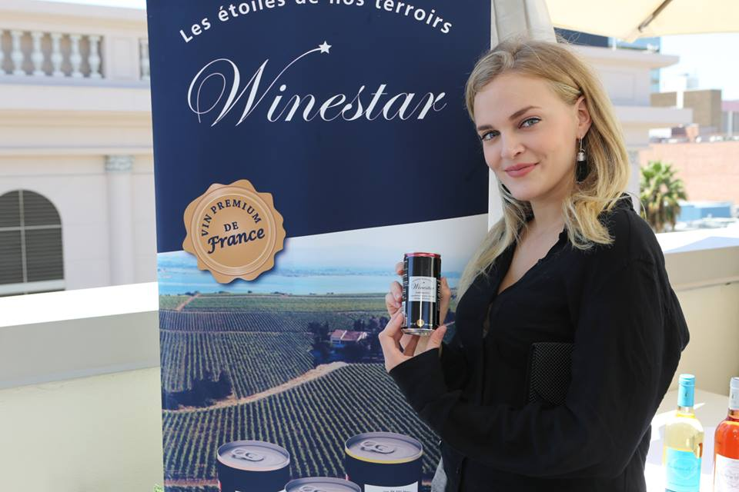
Promotion and media
CELEBRITIES USA
Kristin Bauber van Straten
True Blood
Jasmine Dunstin
CSI Miami, GQ Magazine
Madeline Brewer
Orange is the New Black
TJ Miller
Silicon Valley, Deadpool
TV clips : France (BFM, M6, Canal +) Belgium, South Korea, China…

Slide 6
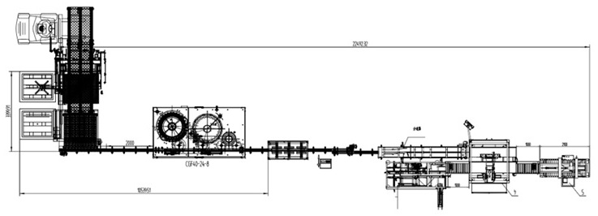
An industrial investment to accelerate our growth
We seize the opportunity to purchase our own wine-in-cans filling line in China to :
Reduce our costs and launch aggressive sales campaigns in China and Asia,
Deploy this pilot plant to other strategic markets (USA, India, Russia, Africa, etc.)

Slide 7
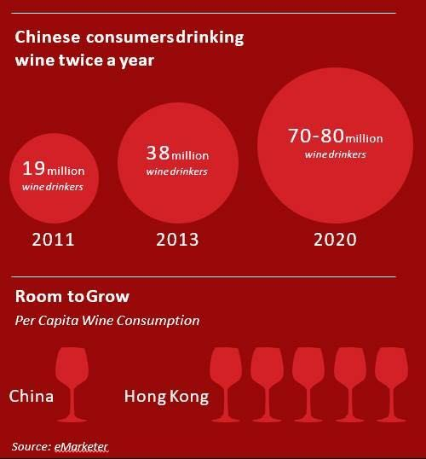
Why China ?
China is already the #1 market for Winestar® with over 1 million cans sold through distributors.
China is a major player of the wine industry :
#1 for red wine consumption !
#2 for wine production area
#4 for wine imports
By 2020, more than 80 million Chinese consumers will drink wine twice per day...
China drinks 5 times less wine per capita than Hong Kong… which demonstrates a strong growth potential.
Cost effective manpower and reduced tax (vs import) enables competitive price and strong sales…

Slide 8
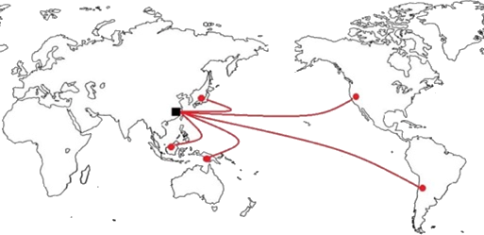
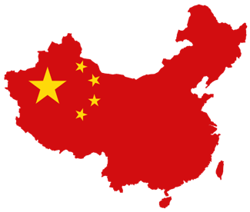
Why in Tianjin, China ?
We identified a Chinese partner who already operates a bottling line which enables us to start quicker, with a lower investment and reduced risk.
The strategic location near the Beijing seaport in the Free Trade Zone reduces logistics costs and serves as a base to export to Asian and American markets.
Discussions pending with Dynasty (#3 Chinese wine producer based in Tianjin) to package their wines in our cans and use their sales channels to distribute Winestar® to millions of Chinese outlets…

Slide 9
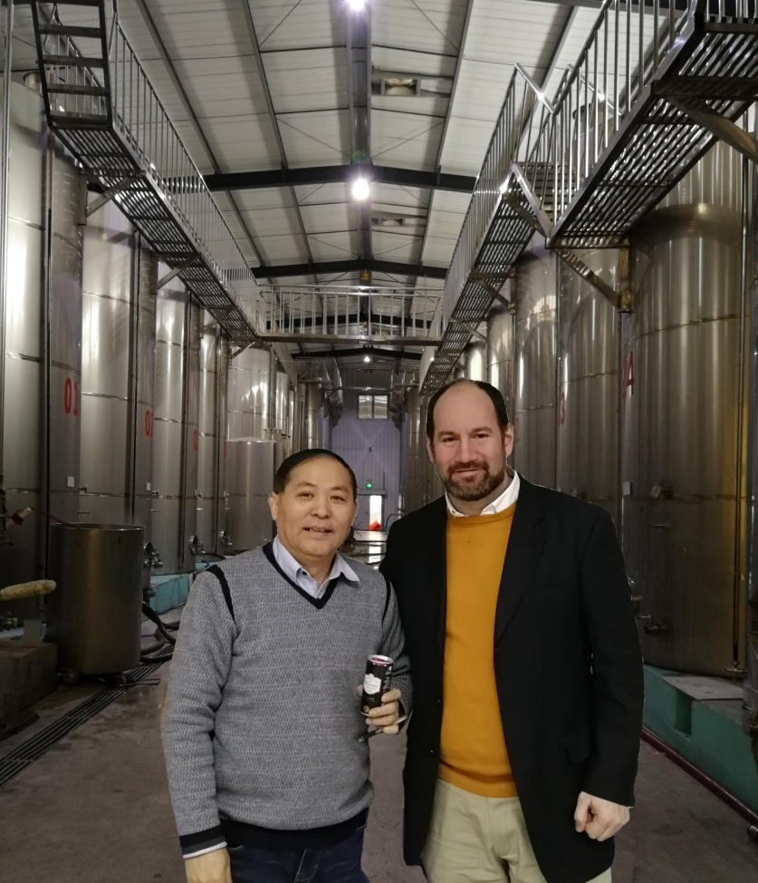
Benefits of working with an existing partner
Using partner’s existing equipment (wine tanks, filtration system, analysis laboratory, etc.) will reduce the initial investment from 1 m€ to 400 k€…
Experienced staff with knowledge of bulk wine import procedures, compliance and technological expertise,
Logistics and customs clearance capability,
China Sanitary food license immediately available,
Will add Winestar® cans to his wine portfolio (already selling 12 million bottles annually…)

Slide 10
Benefits on price competitiveness !
Imported can 187 ml
CIF Price : 7 CNY (0,87 €)
Duties and tax : 50%
Landed price : 10.5 CNY
Final Cost : 10.5 CNY
Can filled in China 187 ml
Wine only CIF Price : 2.4 CNY (0.30 €)
Wine duties and tax : 50%
Wine landed price : 3.6 CNY
Production cost (estimate) : 1.4 CNY
Final Cost : 5 CNY
A competitive pricing to
generate more sales !!!

Slide 11
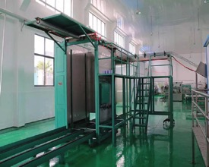
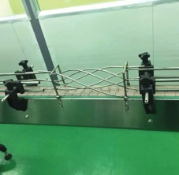
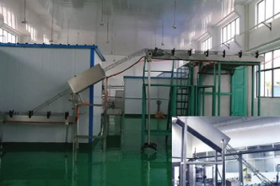
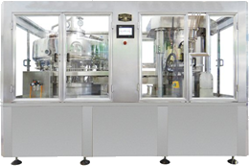
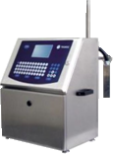
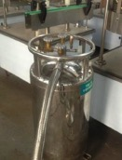
Wine filling line details
Depalettizer and conveyor
Wine filler, nitrogen doser and coding machine

Slide 12
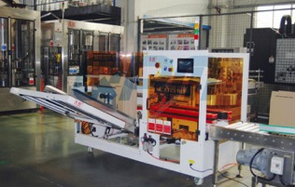
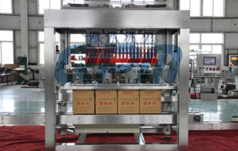
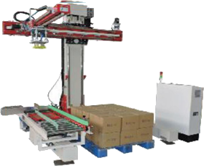
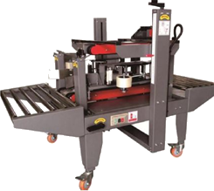
End of line details
Carton opener and filler
Carton sealer and palettizer

Slide 13
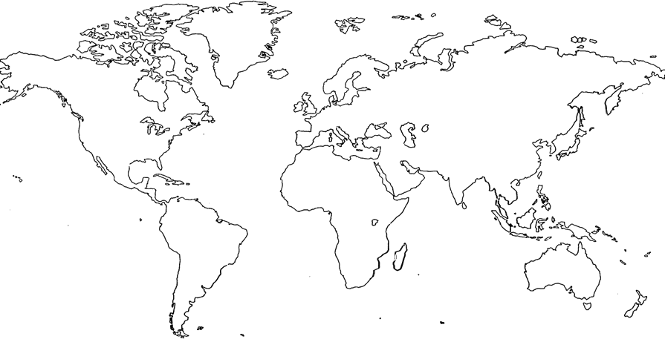
Next … the Winestars
- Deploy the wine in can filling line in all strategic markets :
Europe, USA, South America (Chile, Argentina), India, Russia, Africa, …
- Start local wine production under Winestar® quality specs,
- Export to Winestar® global markets and distributors.

Slide 14
Strategy
2018-19 Sales: 2 m€ Profit : 300 k€ | Setup filling line in Tianjin Free Trade Zone, Hire 2 technicians and 1 manager, Target 100 stores (import food shop, liquor stores, bars, restaurants).
2019-20 Sales: 4 m€ Profit : 800 k€ | Expand to other cities through wholesalers Hire 2 sales staff, Target 500 customers, Launch of wines from China for domestic and export markets.
2020-21 Sales: 8 m€ Profit : 2 m€ | Expand to all of China, Recruiting additional brand ambassadors and sales coordinator, Target 1000 customers.

Slide 15
Sales forecast
 | 2018-19 | 2019-20 | 2020-21 | 2021-22 | 2022-23
Revenue( in k€ ) | 2 000 | 4 000 | 8 000 | 12 000 | 16 000
Profit (in k€ ) | 300 | 800 | 2 000 | 3 000 | 4 000
Staff | 3 | 5 | 6 | 8 | 10

Slide 16
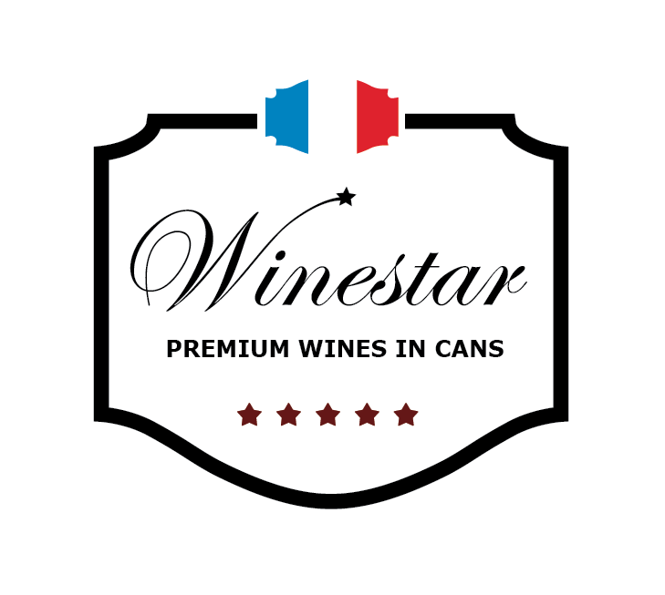
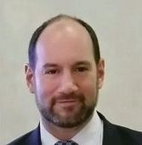
Invest in a future wine leader...
Fabulous Brands SAS
French corporation with equity of € 690 765
Headquarters in Paris, FRANCE
Turnover : 730 k€ (2016)
Banks : Société Générale, CIC
Founder and CEO: Cédric Segal (ISG Paris business school)
Current equity structure :
Founder : 83 %
Business angels : 17 %
Fund raising target : 400 k€
Investment | 400 000 € | 200 000 € | 100 000 € | 50 000 € | 20 000 €
Shares | 12 000 | 6 000 | 3 000 | 1 500 | 600
% equity | 16 % | 8 % | 4 % | 2 % | 0.8 %

Slide 17
Projected use of funds
Machines – 200 k€
automated filling line
setup costs
Initial recruitments – 40 k€
1 line manager
2 technicians
Marketing and communication – 50 k€
support local distributors
promotional campaigns
trade shows
R&D and intellectual property – 40 k€
develop and register patent to protect the know-how developed on this new equipment
Working capital requirement – 70 k€
operating costs
duties and tax

Slide 18
Detailed forecast Year 1
Working assumptions
Wholesale price in € | 1.00
Wholesale price in CNY | 8
Sales (units) | 2 000 000
Can size in ml | 187
Operating costs (% of units) | 10 %
Communication (% of sales) | 3 %
Sales commission and incentives | 10 %
# of full time employees | 3
Wine cost (hl) DDU | 120 €
Import duty on wine | 20 %
Wine cost (hl) incl duty | 144 €
Purchase of filling line and setup | 200 k€
Technician monthly salary | 1 000 €
Manager/Sales monthly salary | 1 500 €
Company tax rate | 30%
R & D and IP (% of sales) | 3%
in k€ | 2018-19
SALES | 2 000
Cost of empty cans | 120
Cost of wine | 540
Cost of filling | 100
Sales commissions and incentives | 200
Operating costs and insurance | 200
Communication and marketing | 60
Salaries | 50
R & D | 60
EBITDA | 670
Purchase of machine and setup | 200
Company tax | 140
NET PROFIT | 330
Production cost - variable
Empty can | 0.06 €
Wine 187 ml | 0.27 €
Filling / packing | 0.05 €
TOTAL | 0.38 €

Slide 19
Detailed forecast Year 2
Working assumptions
Wholesale price in € | 1.00
Wholesale price in CNY | 8
Sales (units) | 4 000 000
Can size in ml | 187
Operating costs (% of units) | 10 %
Communication (% of sales) | 3 %
Sales commission and incentives | 10 %
# of full time employees | 3
Wine cost (hl) DDU | 120 €
Import duty on wine | 20 %
Wine cost (hl) incl duty | 144 €
Purchase of filling line and setup | 200 k€
Technician monthly salary | 1 000 €
Manager/Sales monthly salary | 1 500 €
Company tax rate | 30%
R & D and IP (% of sales) | 3%
in k€ | 2019-20
SALES | 4 000
Cost of empty cans | 240
Cost of wine | 1 080
Cost of filling | 200
Sales commissions and incentives | 400
Operating costs and insurance | 400
Communication and marketing | 120
Salaries | 80
R & D | 120
EBITDA | 1 360
Packaging and sleeve machines | 200
Company tax | 350
NET PROFIT | 810
Production cost - variable
Empty can | 0.06 €
Wine 187 ml | 0.27 €
Filling / packing | 0.05 €
TOTAL | 0.38 €

Slide 20
Detailed forecast Year 3
Working assumptions
Wholesale price in € | 1.00
Wholesale price in CNY | 8
Sales (units) | 8 000 000
Can size in ml | 187
Operating costs (% of units) | 8 %
Communication (% of sales) | 5 %
Sales commission and incentives | 10 %
# of full time employees | 3
Wine cost (hl) DDU | 120 €
Import duty on wine | 20 %
Wine cost (hl) incl duty | 144 €
Purchase of filling line and setup | 200 k€
Technician monthly salary | 1 000 €
Manager/Sales monthly salary | 1 500 €
Company tax rate | 30%
R & D and IP (% of sales) | 3%
in k€ | 2020-21
SALES | 8 000
Cost of empty cans | 480
Cost of wine | 2 160
Cost of filling | 400
Sales commissions and incentives | 800
Operating costs and insurance | 480
Communication and marketing | 400
Salaries | 100
R & D | 240
EBITDA | 2 940
Company tax | 880
NET PROFIT | 2 060
Production cost - variable
Empty can | 0.06 €
Wine 187 ml | 0.27 €
Filling / packing | 0.05 €
TOTAL | 0.38 €

Slide 21
Contact
Fabulous Brands SAS
120 boulevard Camélinat
92240 Malakoff
France
Cédric Segal
Tel. +33 (0) 6 62 25 03 59
Email : cedric.segal@fabulousbrands.eu

